Slide 1


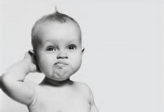
Thinking about Thinking….
Jo Sintes
We can´t solve our problems with the same level
of thinking that created them - Albert Einstein

Slide 2
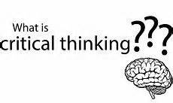

Slide 3
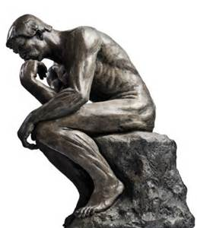
When you think of someone you consider
an effective critical thinker,
What attributes do you attach to that
person?

Slide 4
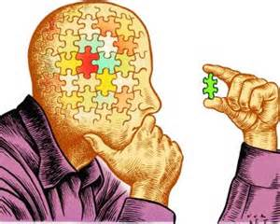
Ask relevant questions
Are curious
Are aware of their own biases
Open to changing their opinions
Formulate well reasoned arguements
Reserve judgement until they have the facts

Slide 5
What is Critical Thinking?
Its the ability to:
Solve problems
Be flexible, creative and original
Think about thinking
Locate the appropriate route to a goal
Express views and feelings appropriately

Slide 6
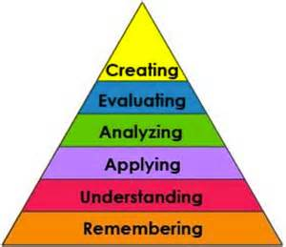
Blooms Taxonomy _
from LOTS
To HOTS

Slide 7
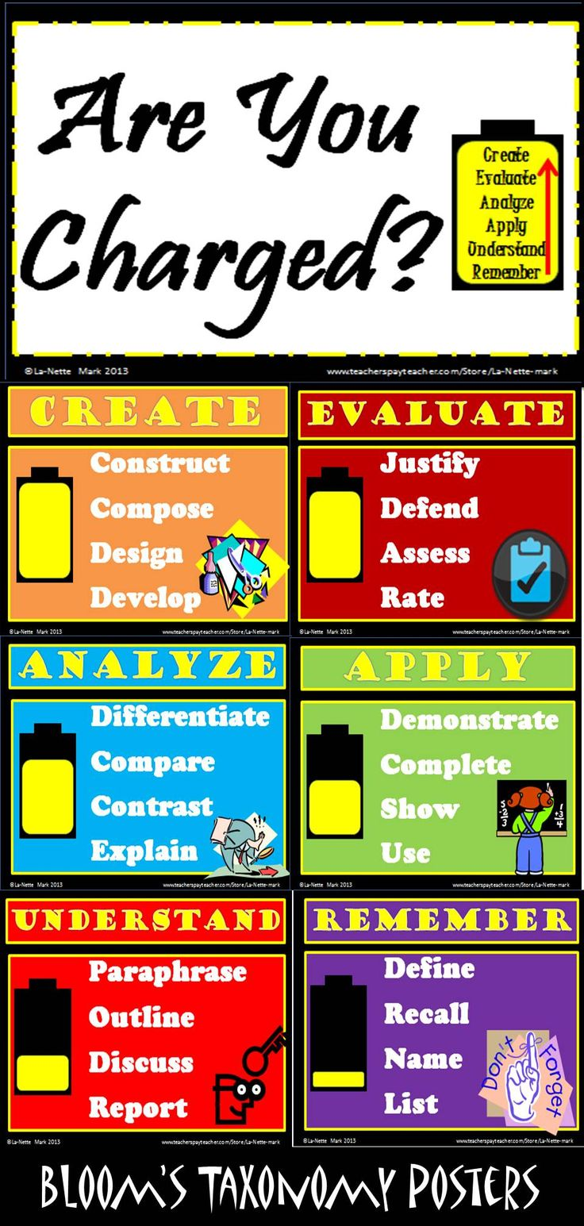

Slide 8
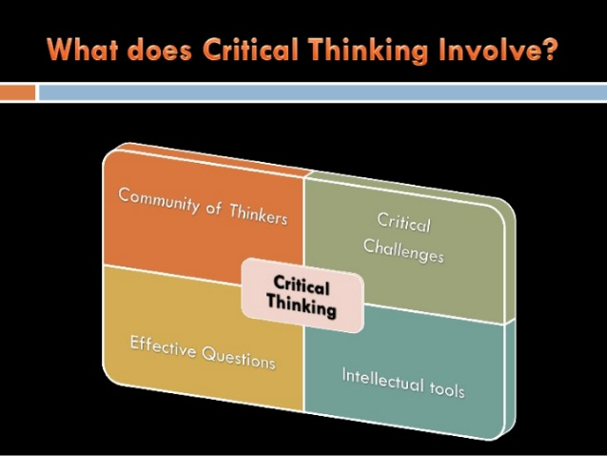

Slide 9
What is a “Community of Thinkers”?
Teachers
Students
Safe classroom
Community of thinkers

Slide 10
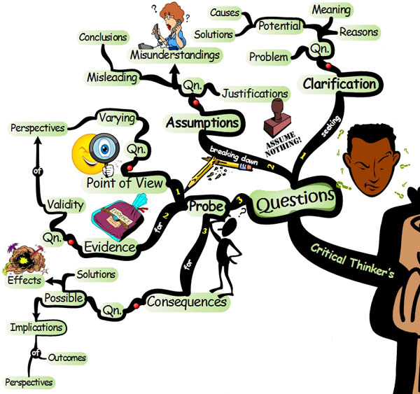
TOOLS - Visual Organisers
Notes:
Make a list of as many as you can…..

Slide 11
How many can you name?
Concept map
Mind map
Venn diagram
Timeline
Organisation chart
Flow diagram
Spiders web
Ishikawa (cause and effect)

Slide 12
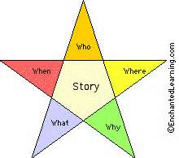
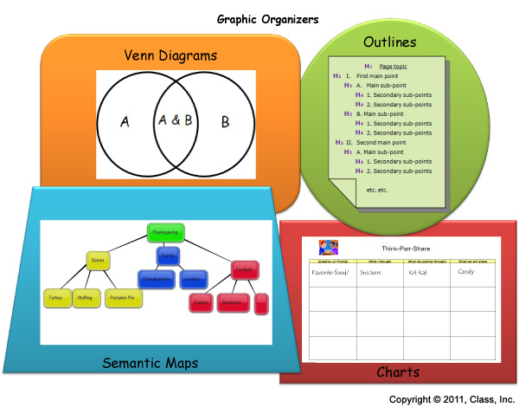
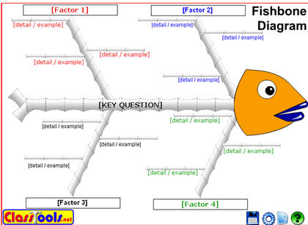
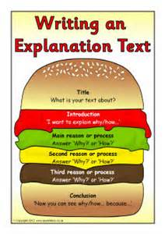

Slide 13
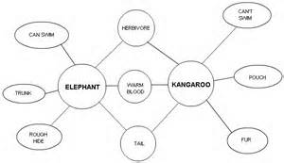
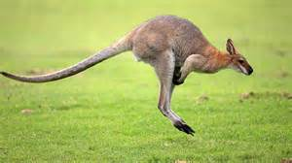
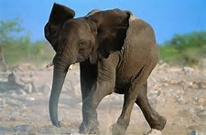
DOUBLE BUBBLE

Slide 14
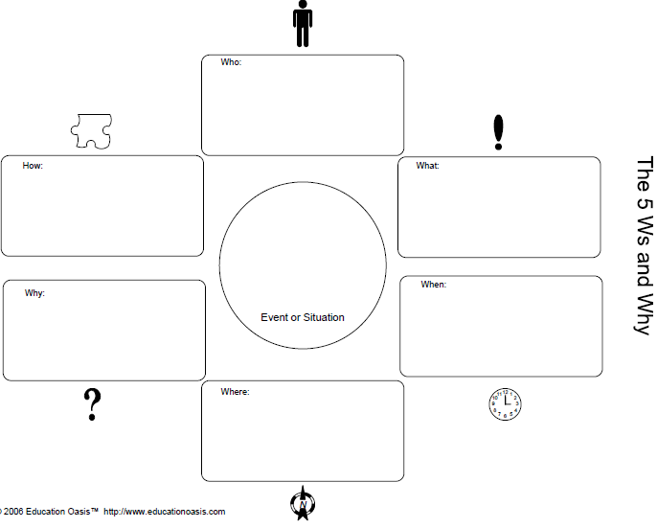

Slide 15
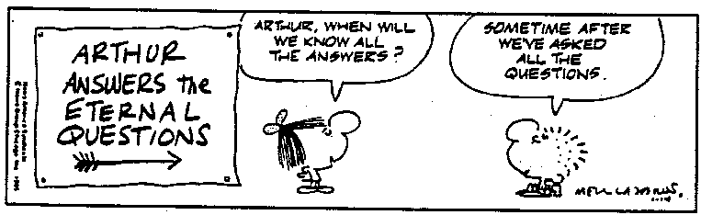
QUESTIONS

Slide 16
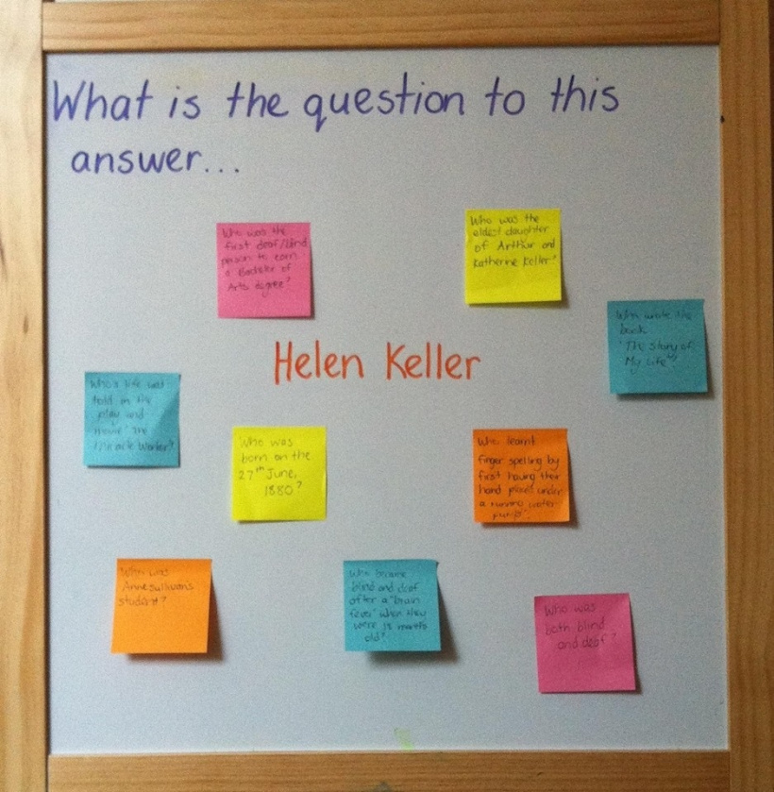

Slide 17

Why – help find the root of the problem
What if – opens up the floor for creative solutions
How - focus on developing practical solutions

Slide 18
What can you expect?
Excitement - puts the student in the centre
Distress - challenging to start with
Acceptance – recognise that there are no right answers
Application – naturally using structures.

Slide 19


Skinny & Fat Questions
What is the average temperature in summer in Spain?”
How does the average temperature change during a typical year in Spain?

Slide 20

Great Questions
What´s happening?
What else? What if?
How do I know?
Who is saying it?
What don´t I see?
Why is it important?

Slide 21

:
.
ALLOW children ample time to think and respond
ASK questions
WELCOME different strategies
GIVE helpful hints
GUIDE children
ENCOURAGE them to check their work
INVITE them to share

Slide 22
Only got 5 minutes?
What kind of soup would you eat for dessert?
What are some ways you could celebrate "Backwards Day?“
Are you more like a square or a circle? Why?

Slide 23
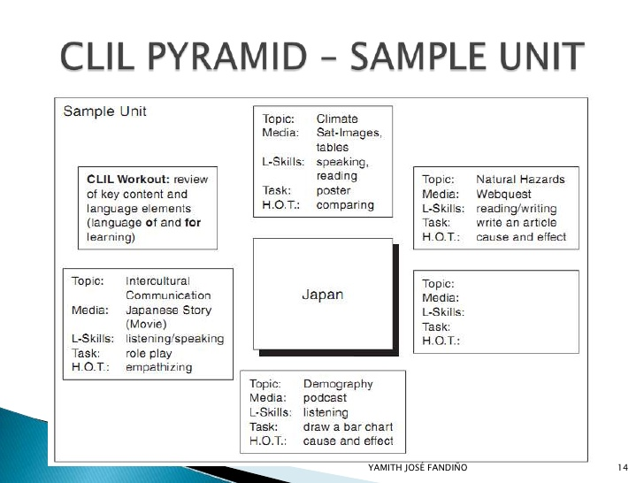

Slide 24
Why bother with Critical Thinking?
“We are currently preparing students for jobs that don´t yet exist, using techonologies that haven´t yet been invented, in order to solve problems we don´t even know are problems yet”

Slide 25
Further reading
www.criticalthinking.org/pages/defining-critical-thinking/766
www.criticalreading.com/critical_thinking.htm
http://reliefteachingideas.com
http://ptthinktank.com/2014/01/06/metacognition-critical-thinking-and-science-based-practice-dptstudent/
www.academia.edu/4893502/The_CLIL_ball_and_thinking_skills
www.teachthought.com/learning/14-brilliant-blooms-taxonomy-posters-for-teachers/
http://www.slideshare.net/teacheryamith/clil-lesson-planning-9599653

